Slide 1
Click Through Rate Prediction for Local Search Results
Sourse: WSDM 2017
Advisor: Jia-Ling Koh
Speaker: Hsiu-Yi,Chu
Date: 2017/3/28

Slide 2
Outline
Introduction
Method
Experiment
Conclusion

Slide 3
Introduction
Motivation
users prefer businesses that are physically closer to them. However, this notion of closeness is likely to depend upon other factors, like the category of the business, the quality of the service provided, the density of businesses in the area of interest, etc.

Slide 4
Introduction
Goal
we address the problem of estimating the click-through rate on local search results (LCTR) as a proxy for deciding the best entries that should be displayed for a given user’s query.

Slide 5
Outline
Introduction
Method
Experiment
Conclusion

Slide 6
Method
Input: log D
information of business:
>title >description >display URL
>business category >average user’s rating >location(GPS)
LCTR(local search click-through-rate):

Slide 7
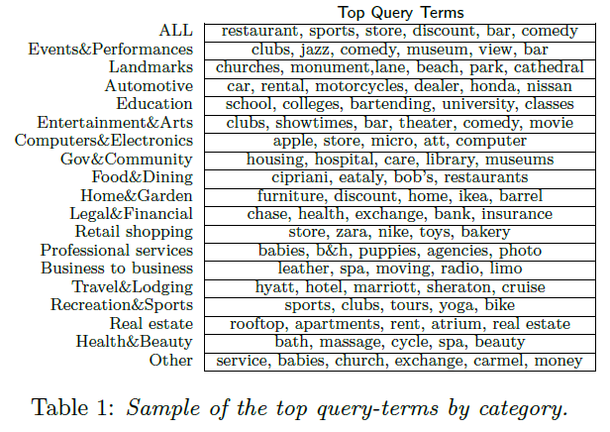
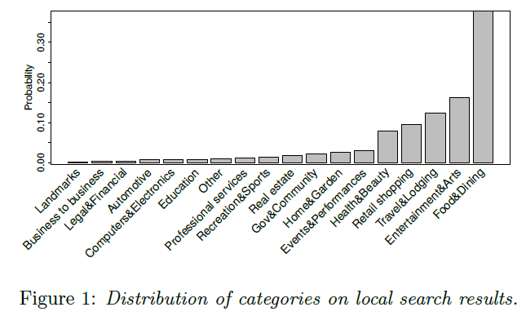
Method
Local search intent.

Slide 8
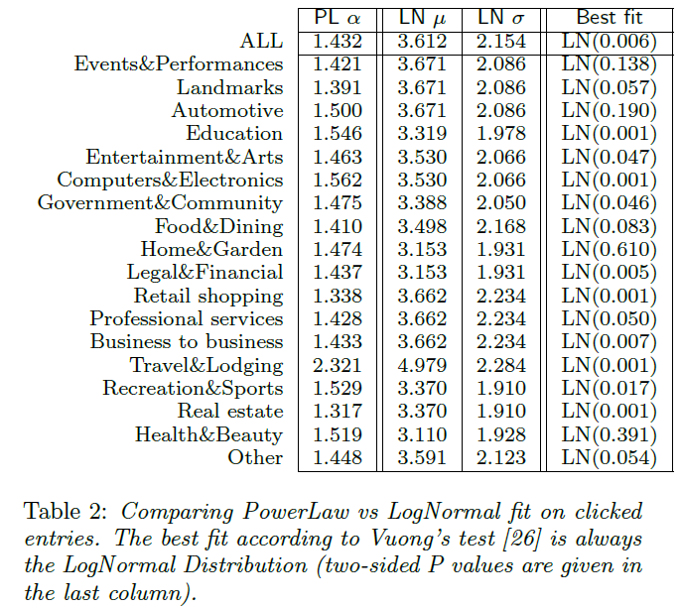
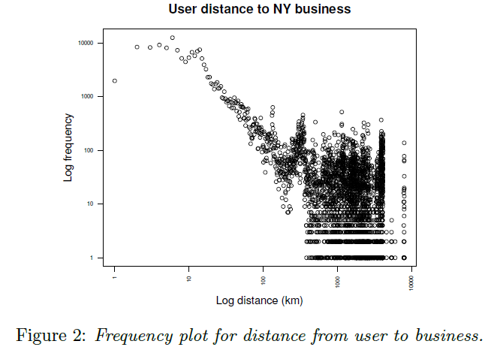
Method
Analysis of the distance.
https://zh.wikipedia.org/wiki/%E5%AF%B9%E6%95%B0%E6%AD%A3%E6%80%81%E5%88%86%E5%B8%83

Slide 9
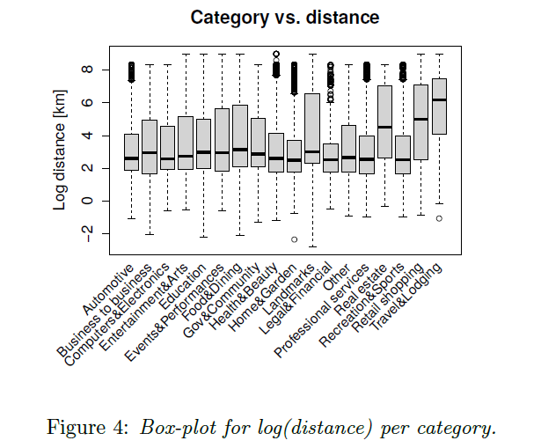
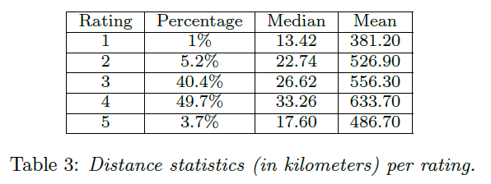
Method
Distance vs rating.
Distance vs. category.

Slide 10
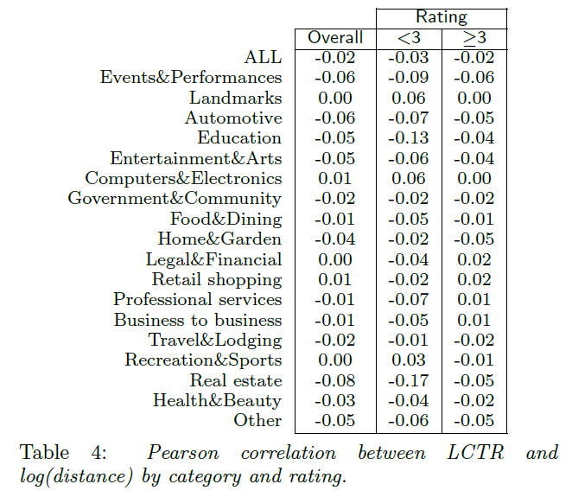
Method
Distance vs. category.
Distance vs. LCTR.

Slide 11
Method
LCTR Prediction

Slide 12
Method
Text-based features
1.BM25
2.BM25F
3.LSI
http://www.zwbk.org/zh-tw/Lemma_Show/257113.aspx
Business-dependent features
1. Category
2. Rating
3. RatingDev

Slide 13
Method
Geographical features
Explicit local query indicator.
1. EQ
2. GeoLocID
Zip codes.
1. QZip
2. BZip

Slide 14
Method
Geographical features
Distance.
1. Distance
2. LogDist
3. LkDist:
4. LkDistCat:

Slide 15
Method
Geographical features
Zip profile.
1. CntBusiness(Bzip)
2. CntBusinessByCat(Bzip)
3. ProbCat(Bzip)
4. CntBusinessCurrCat(Bzip)
5. ProbCurrCat(Bzip)
6. EntropyCat(Bzip):
7. AvgRating(Bzip)
8. AvgRatingByCat(Bzip)
9. AvgRatingCurrCat(Bzip)

Slide 16
Outline
Introduction
Method
Experiment
Conclusion

Slide 17
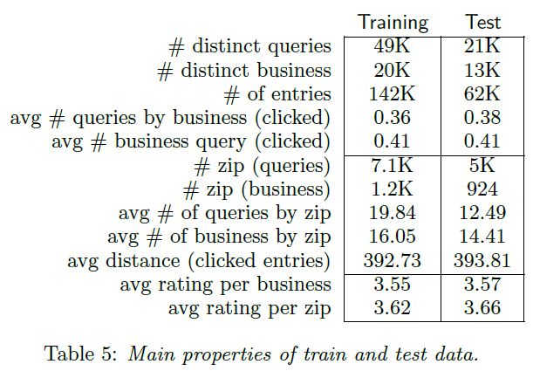
Experiment
Data
GBDT(Gradient Boosting Decision Tree)

Slide 18
Experiment
Evaluation on CTR prediction

Slide 19
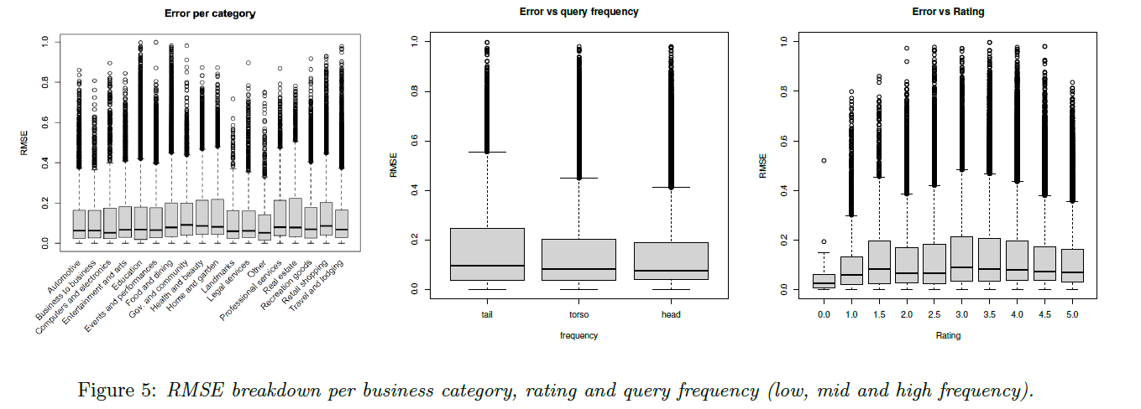
Experiment
Error analysis.

Slide 20
Experiment
Linear vs non-linear classifiers.

Slide 21
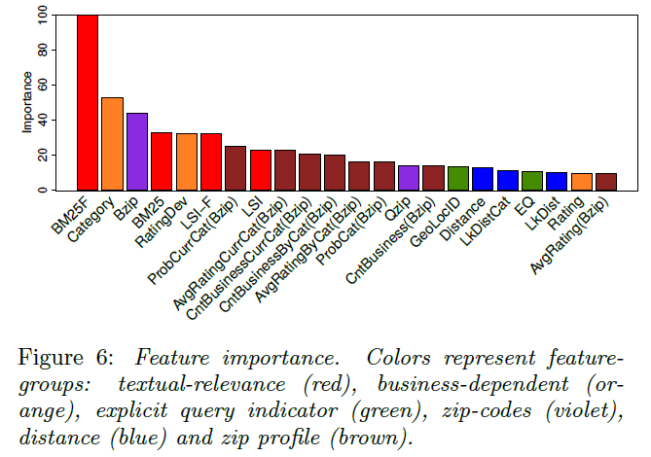
Experiment
Feature importance.

Slide 22
Outline
Introduction
Method
Experiment
Conclusion

Slide 23
Conclusion
we present an extensive study to characterize and predict online users’ behavior on local search.
we focus on the problem of estimating the click-through rate on the different local search results according to two complementary perspectives (regression and binary classification).
Our evaluation shows that the overall approach proposed in this paper outperforms a geolocation-aware baseline that combines textual information.

