Slide 1
Node2vec:Scalable Feature Learning for Networks
Source : KDD 2016
Advisor : JIA-LING KOH
Speaker : YI-CHENG HUNG
Date:2018/10/16

Slide 2
Outline
Introduction
Method
Experiment
Conclusion

Slide 3
Outline
Introduction
Method
Experiment
Conclusion

Slide 4
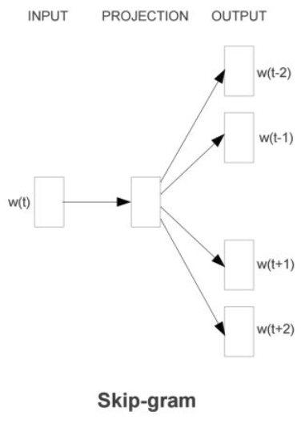
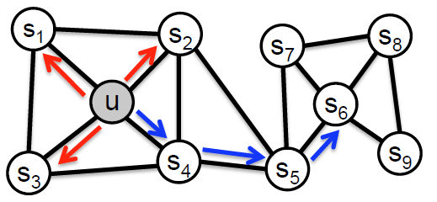
Introduction
Strategy(造句)
{s2,s1,s3…}
{s4,s5,s6…}
….

Slide 5
Outline
Introduction
Method
Experiment
Conclusion

Slide 6
Notation
Given network
Mapping function
Source node
Network neighborhood of node u generated through a neighborhood sampling strategy S

Slide 7
Problem definition-objective function
Assumptions
Conditional independence(條件獨立)
Symmetry in feature space(空間上的對稱性)
Notes:
條件獨立性假設：即假設結點間相互獨立，簡單來說就是，對於某一個源結點，其採用到的鄰居結點是獨立的，採用其中一個鄰居結點不會對其他鄰居結點造成影響。
特徵空間對稱假設：源結點和鄰居結點的特徵空間有一個對稱性影響。簡單來說就是，一個源結點和其某一個鄰居結點有關係，那麼對於這個鄰居結點來說，這個源結點也是其鄰居結點，影響是相互的。

Slide 8
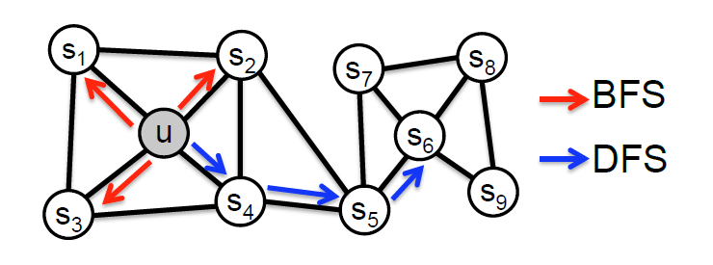
Classic search strategies-BFS(Breadth-first sampling)
Homophily(同質性)
Microscopic-view

Slide 9
Classic search strategies-DFS(Depth-first sampling)
Structural equivalence(結構相似)
Macro-view
Notes:
直觀上來理解，廣度優先遍歷更容易採樣鄰居結點，這更容易表示結構相似性。此外，廣度優先遍歷採樣鄰居結點往往重複多次採樣，這有利於減少偏差。對於深度優先遍歷來說，它盡可能深的遍歷網絡，起到了一個宏觀上的反應。這更容易表示內容相似性，即驗證同質性假設。但是，過深的採樣，增大了複雜度。而且，當深度達到一定程度，即兩個結點之間距離較遠，大多數時候，這兩個結點可能沒什麼關係了。

Slide 10
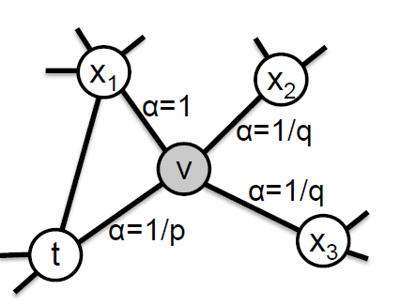
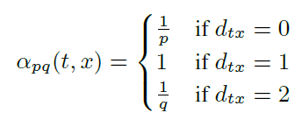
node2vec
Random walks
Search bias

Slide 11
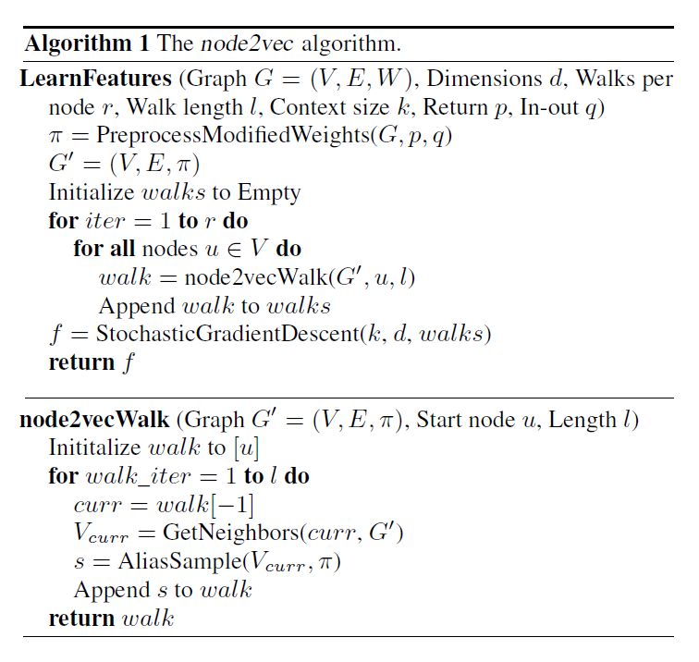
The node2vec algorithm

Slide 12
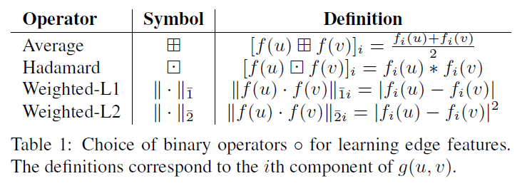
Learning edge features

Slide 13
Outline
Introduction
Method
Experiment
Conclusion

Slide 14
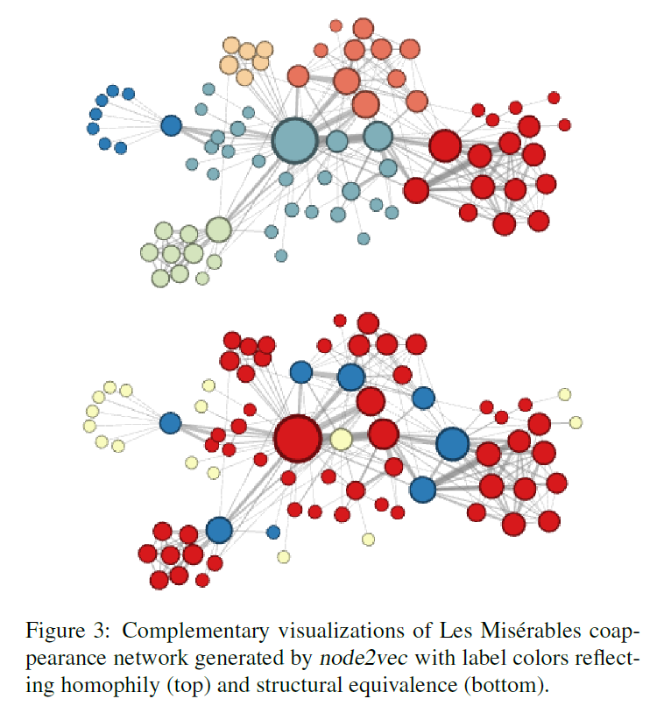
Case study
p=1
q=0.5
p=1
q=2

Slide 15
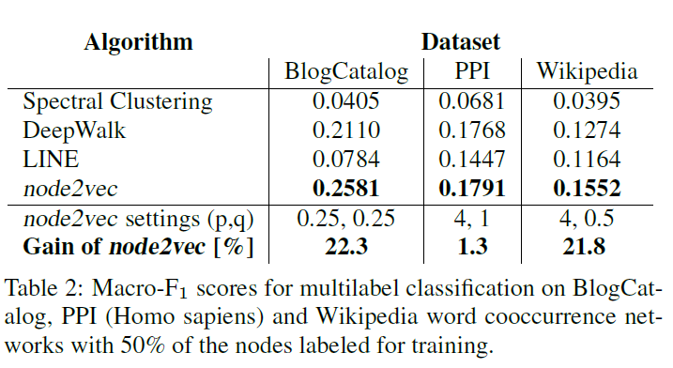
Experimental results on classification

Slide 16
Performance evaluation of different benchmarks

Slide 17
Parameter sensitivity

Slide 18
Perturbation analysis

Slide 19
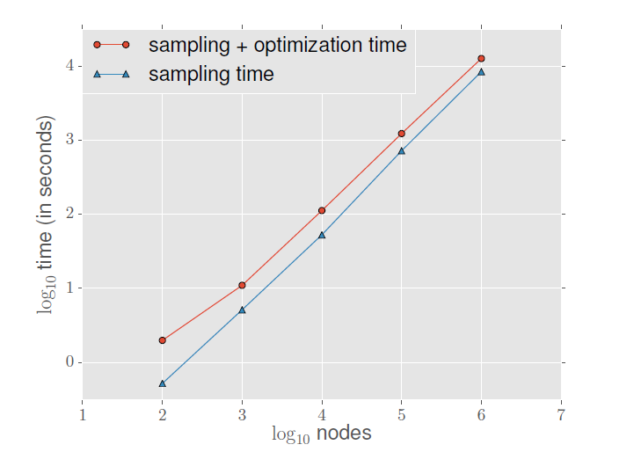
scalability

Slide 20
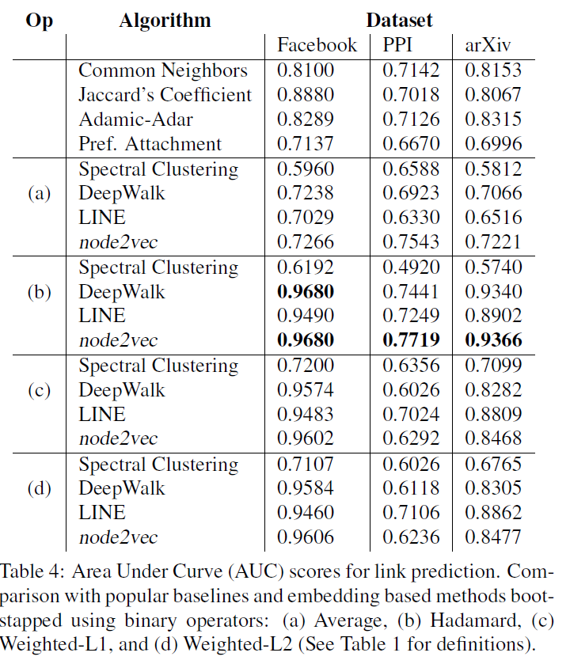
Link prediction

Slide 21
CONCLUSION
we studied feature learning in networks as a searchbased optimization problem.
the search strategy in node2vec is both flexible and controllable exploring network neighborhoods through parameters p and q.

